Slide 1

Accident Database Analysis
Presenter : Ms. Raunak Masih
Student Number : 202405832
Course : Big Data and Data Mining

Slide 2
Introducing the potential technical, ethical and legal issues of storing the data

Slide 3


Technical Issues Bala(2022)
One of the biggest challenges in data protection is preventing unwanted access, breaches, and cyberattacks.
Large datasets become more difficult to manage and handle as data volumes rise.
For stored data to be reliable and usable, it must be accurate and consistent.

Slide 4
Ethical Issues Bala(2022)
In academic settings, the inappropriate use of data is a major concern.
A significant ethical dilemma in business is safeguarding private or sensitive information.
Conclusions that are misleading can arise from incorrect data interpretation.
A major ethical concern is the unethical use of research instruments, methods, and standards.

Slide 5
Legal Issues Bala(2022)
It's critical to abide by the laws and regulations pertaining to data protection.
The study raises concerns about the "incorrect application of the 'right to science' in international law," pointing to potential legal nuances with the usage of data in research.
It is crucial to take legal sharing procedures and data ownership into account.

Slide 6
How might an SQL relational database address some of these?

Slide 7
Technical Consideration Acha(2021)
User authentication and authorization.
Audit logs to monitor database activities.
Constraints such as Primary keys, foreign keys, Unique constraints.
Indexing for optimized data retrieval.
Partitioning a large table into smaller, more manageable sections.

Slide 8
Ethical Considerations Acha(2021)
Data masking to obscure sensitive information.
The process of using pseudonyms in place of private identifiers.
Information about user consent is stored in metadata tables.
Mechanisms to enforce permission-based data use.

Slide 9
Legal Consideration Acha(2021)
Automated data retention guidelines for archiving or deleting.
Data categorization and tagging for responsible management of private information.
Effective data retrieval for requests for subject access
Features of data portability for exporting information in organized formats.
Change tracking to record modifications to data and schema.
Access logging to document who accessed what data and when.

Slide 10
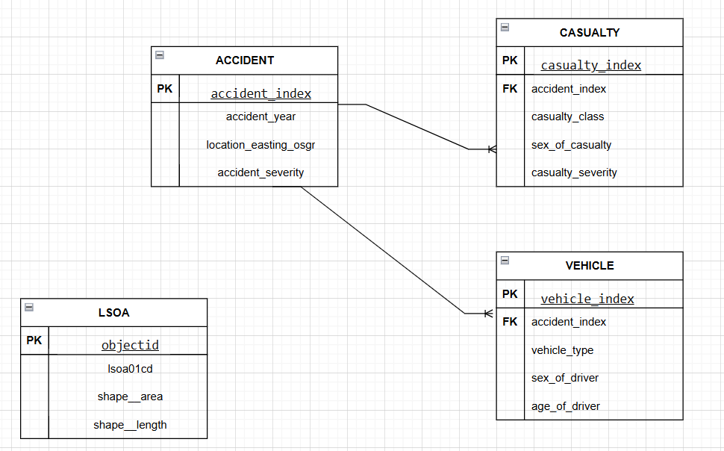
Representation of the E-R Diagram

Slide 11
Description of the E-R Diagram
Accident Table:
Functions as the database's main entity.
The accident_index is used to identify unique accident entries in the dataset.
The location of the incident (location_easting_osgr), the year it happened (accident_year), and the severity of the accident (accident_severity) constitute key points of information.

Slide 12
2. Casualty Table:
keeps records of those who have been engaged in accidents.
Casualty_index serves as a unique identifier for each casualty record.
Each casualty is linked to a specific accident, which is indicated by the foreign key accident_index, which is connected to the Accident table.
The columns casualty_class (which indicates the type of casualty), sex_of_casualty, and casualty_severity are representative

Slide 13
3. Vehicle Table:
Includes information about the vehicles involved in accidents.
Vehicle_index serves as a unique identifier for each vehicle record.
connected to the Accident table via the foreign key accident_index, which shows the specific accidents in which each vehicle has been involved.
The vehicle_type, sex_of_driver, and age_of_driver are representative columns.

Slide 14
4. LSOA Table:
keeps track of geographical information concerning locations.
Objectid provides a unique identity for each place.
Shape__length, shape__area, and lsoa01cd (location code) are examples of representative columns.

Slide 15
Providing SQL statements for the Queries.

Slide 16

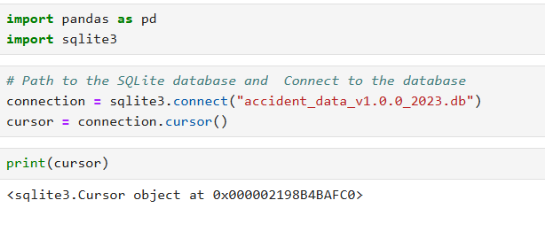

Importing Libraries, Database Connection.

Slide 17
Explanation:
Import sqlite3: This imports the SQLite library to interact with the database.
Import Pandas: For analysis and data manipulation.
The sqlite3.connect() function creates a connection object that allows interaction with the database.
create a cursor object using the connection.cursor() method.
The cursor is used to execute SQL queries and fetch results from the database

Slide 18
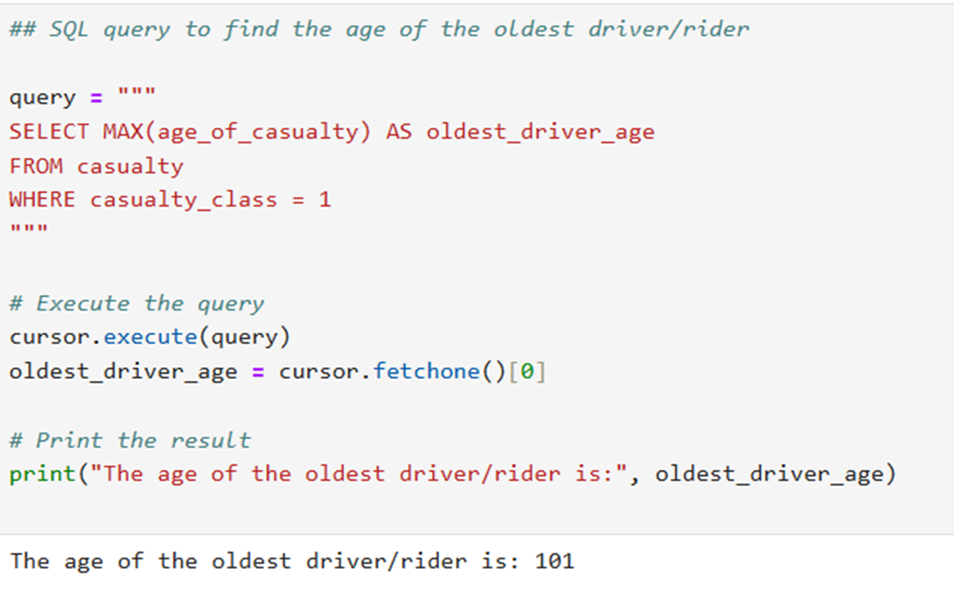
The SQL Query for the age of the oldest driver/rider in the casualty table.

Slide 19
Explanation
SQL Query: The query retrieves the maximum value of the age_of_casualty column from the casualty table.
MAX() function to find the oldest age among drivers or riders (casualties).
WHERE casualty_class = 1: presumably representing drivers.
The cursor.execute(query) line executes the SQL query using the cursor object.
fetchone(): Extract first(and only) value from query table.

Slide 20
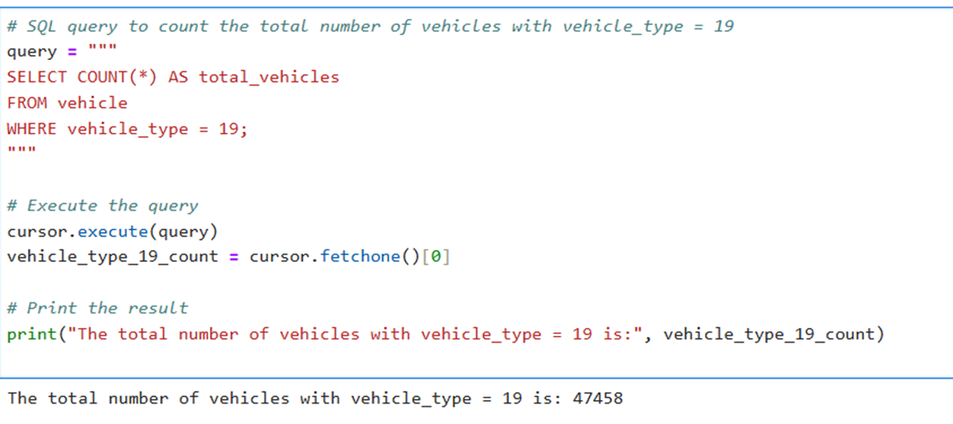
The total number of vehicle_type = 19 vehicles in the vehicle table.

Slide 21
Explanation
SELECT command : This part retrieves the total count of rows from the vehicle table.
WHERE clause : Filters the results to include only rows where the vehicle_type column has a value of 19.
The cursor.execute(query) line executes the SQL query using the cursor object.

Slide 22
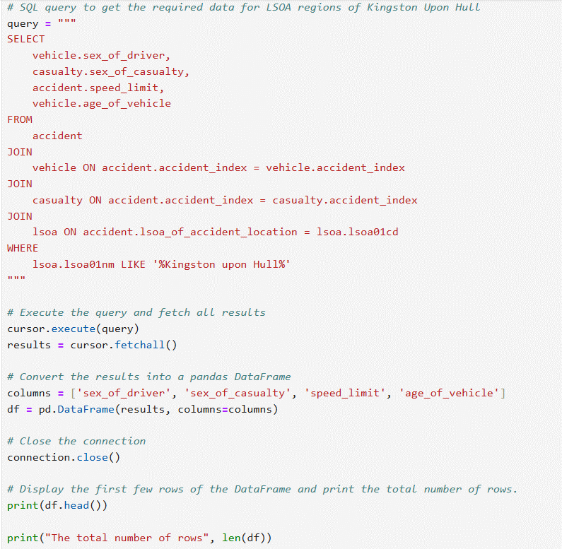
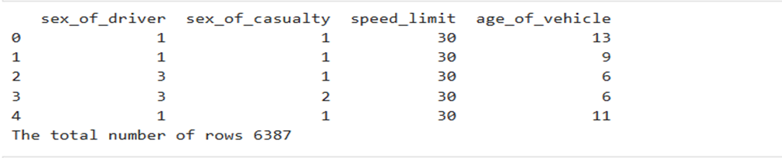
To analyze accidents in Kingston Upon Hull’s Lower Layer Super Output Area (LSOA) regions, join relevant tables and extract data on driver sex, casualty sex, speed limit, and vehicle age.

Slide 23
Explanation
The SQL retrieves data from accident, vehicle, casualty, and lsoa tables usinh JOIN operations.
It selects columns such as sex_of_driver, sex_of_casualty, speed_limit, and age_of_vehicle.
The results are fetched using cursor.fetchall() and stored in the results variable.
The retrieved results are converted into a pandas DataFrame (df) with specified column names.
The connection to the database is closed using connection.close().

Slide 24
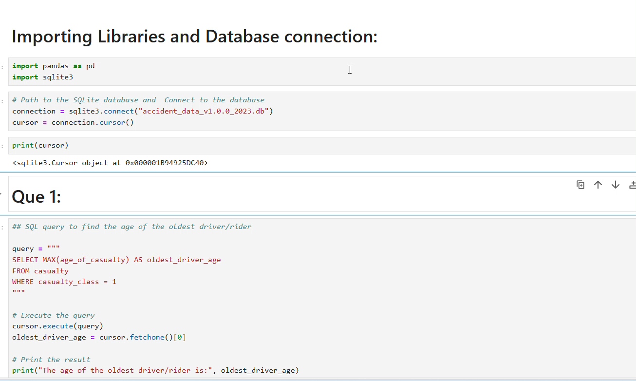

Slide 25
References
Acha, E. (2021) Data SQL Database Database Management System (DBMS): Significance, Ethical, Legal and Professional Outlook.
Bala, R. (2022) ‘Challenges and Ethical Issues in Data Privacy: Academic Perspective’, International Journal of Information Retrieval Research, 12, pp. 1–7. Available at: https://doi.org/10.4018/IJIRR.299938.

Slide 26
Thank You

